Slide 1
Do Housing Market Factors Impact Homelessness Rates?
By: Julie Mammen

Slide 2
Introduction
Do housing market factors affect homelessness?
Examine which housing market factors are the most relevant

Slide 3
Data Sources
U.S. Department of Housing and Urban Development’s report:
Market Predictors of Homelessness
Describes a model-based approach to understanding of the relationship between local housing market factors and homelessness.

Slide 4
Analysis
Train and Test split
Lasso Regression
Ridge Regression
Correlation Matrix
Logarithmic

Slide 5
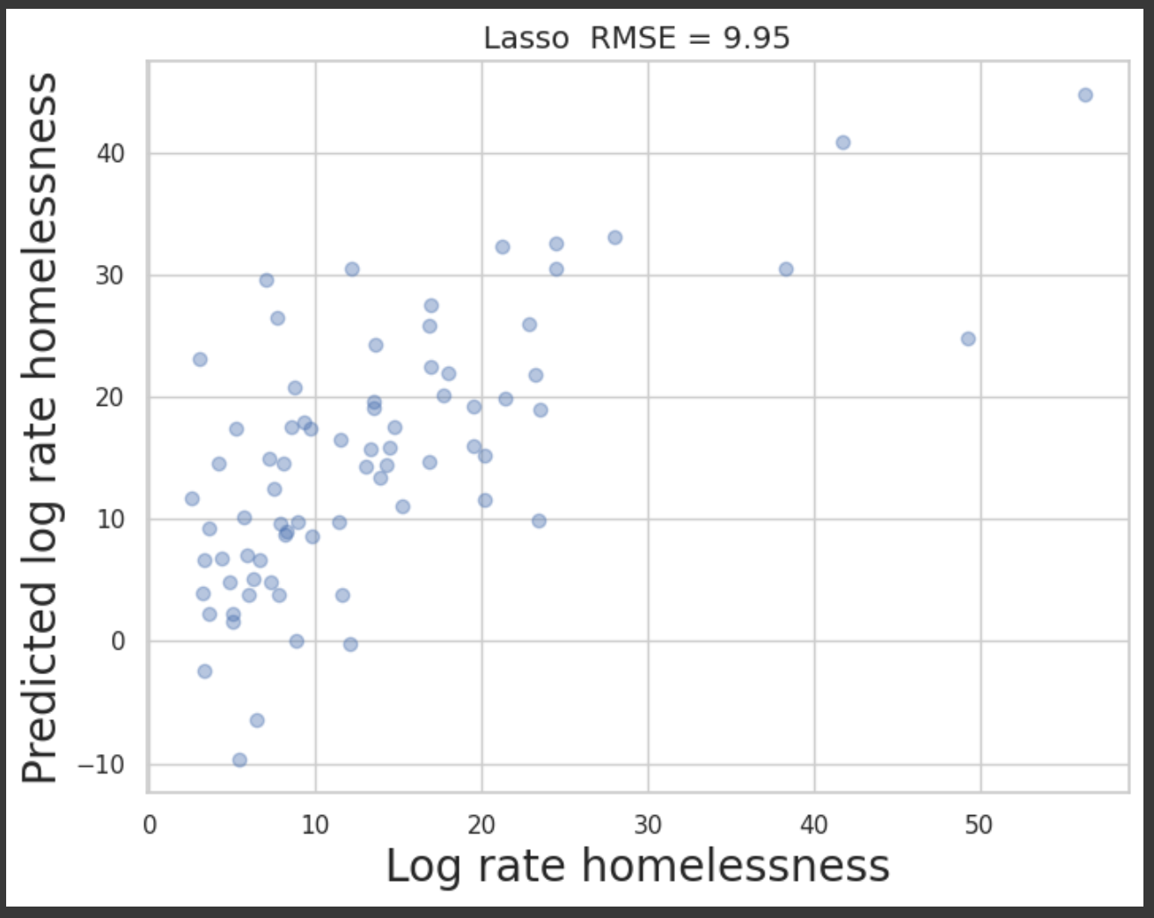
Lasso Regression
5-fold fit

Slide 6
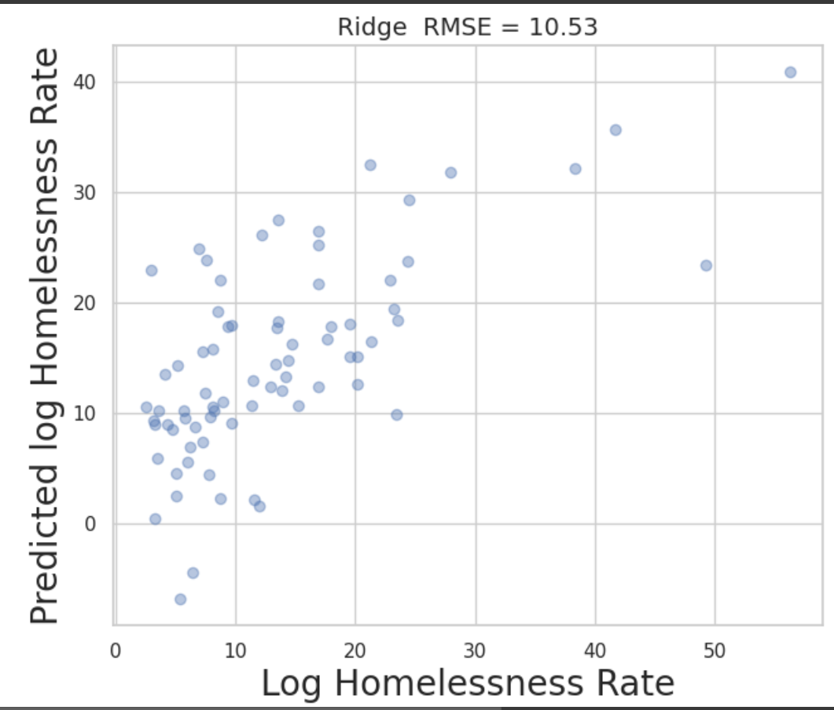
Ridge Regression
5-fold fit

Slide 7
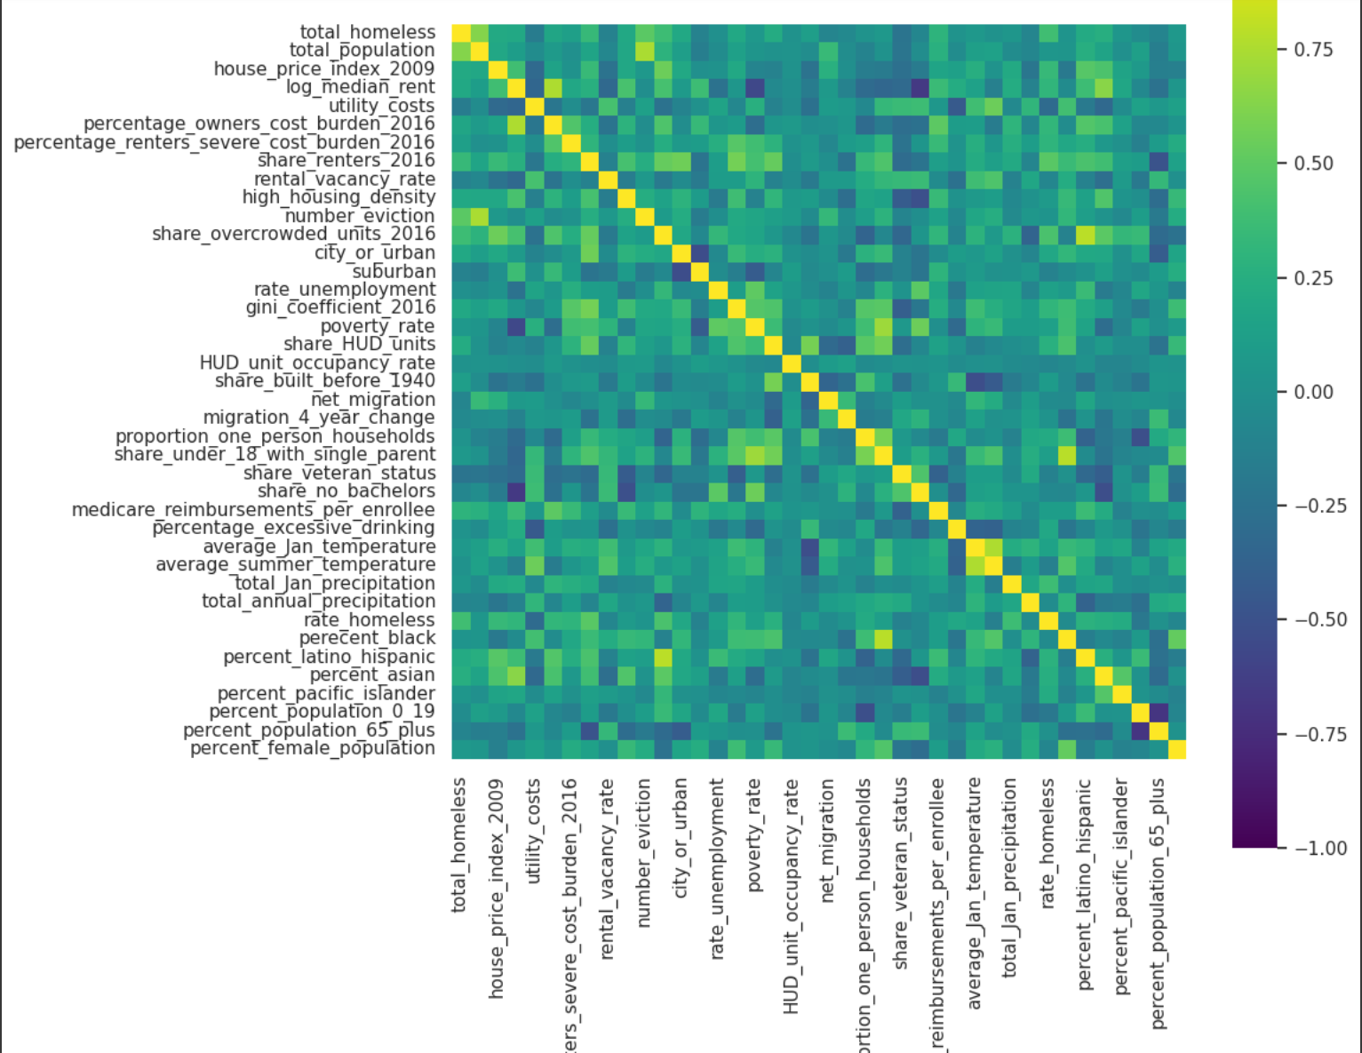
Correlation Matrix
Help with initial choice of predictors

Slide 8
Conclusion
Train and test data is of significant fit with r-squared values over 0.6
Major predictors are:
Log_median_rent
Utility_costs
House_price_index_2009
Share_renters_2016
share_overcrowded_units_2016
Housing market factors can be used to predict homelessness rates
Data only from 2017, estimates, not causal but a factor.

